Slide 1
Predicting premier league match outcomes for Chelsea football club
Capstone project
Nanmaran anbupalam
Data scientist

Slide 2
Agenda
Bio
Project context and stakeholders
Business Value and Data Required
Project Design
Feature Engineering
ML models used
Summary, conclusions and next steps

Slide 3
BIO
EDUCATION
B.E Aernautical Engineering from Anna University, Chennai, India (2011-15)
B.Sc Exercise and Sports Science from ACU Strathfield, Sydney (2016-20)
Programming for Data Science Nanodegree from RMIT (2021)
Data Science and AI certificate from UTS and IOD (current)

Slide 4
Importance of football team success
Chelsea football club, located in London England is an integral part of the global sport and entertainment industry.
In 20/21 total of 2.5 billion pounds in broadcasting and merit payments for EPL teams.
Prize money increases as the team finished higher in the table.
Top 4 teams enter the champions league – where there is a potential to earn a further 85 million euros.
Revenue, sponsorship and fan engagement is directly related to team success - especially in the emerging markets.
Statistical modelling to accurately predict player performance and matchday results is now an integral part of a club’s coaching structure.

Slide 5
Increasing football team success
Business Question:
“How can club management increase team success in EPL to maximize team revenue?"
Data Science Question:
“Can we find important features in matchday statistics and optimize the team performance to maximize the number of wins in a season?”

Slide 6
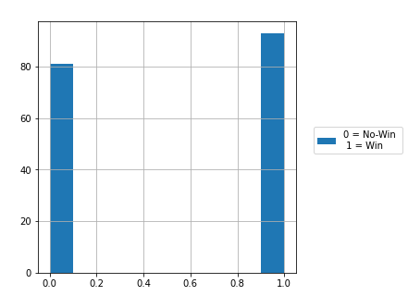
Sourcing data from Fbref and feature selection
All data is sourced from football statistics tracking website fbref.com, who provide in-depth matchday statistics through their partnership with Statsbomb.
R was used to download relevant data EPL matchday statistics for Chelsea, from 2018-2021. (See appendix for the package used to get data)
Initial dataframe had datapoints from 174 matches and 156 features. Literature review (see appendix) was used to filter out the unnecessary features. Final dataframe had 174 matches and 92 features.
SAMPLE OF SELECTED FEATURES
FEATURE | FEATURE EXPLAINED | TYPE
xG | Expected Goals | Attacking
SCA_GCA | Shot/Goal creating actions | Attacking
Cmp_percent_Passes | Total Percentage of passes completed | Passing
PPA | Completed passes into the 18-yard box | Passing
CPA | Carries into the 18-yard box | Possession
Succ_percent_Dribbles | Percentage of Dribbles Completed Successfully | Possession
Def.3rd_Tackles | Tackles in defensive third | Defense
Att.3rd_Pressures | Pressure applied to oppsiton player in attacking third | Defense
Save_percent_Shot_Stopping | Save Percentage | Gaolkeeping

Slide 7
Club Management
Improve team success
Maximize wins and find important features
Collect Data
Team success can be improved
Wins can be predicted. Important features identified
Model Selection
Model fitting and training
Cross-Validation and evaluatiion
Hyper- parameter tuning
Feature Engineering (if required)
Lit Review and feature selection
Build another model to see if it gives better results
OR
Identify solution and plan for implementation
Model Building Process

Slide 8
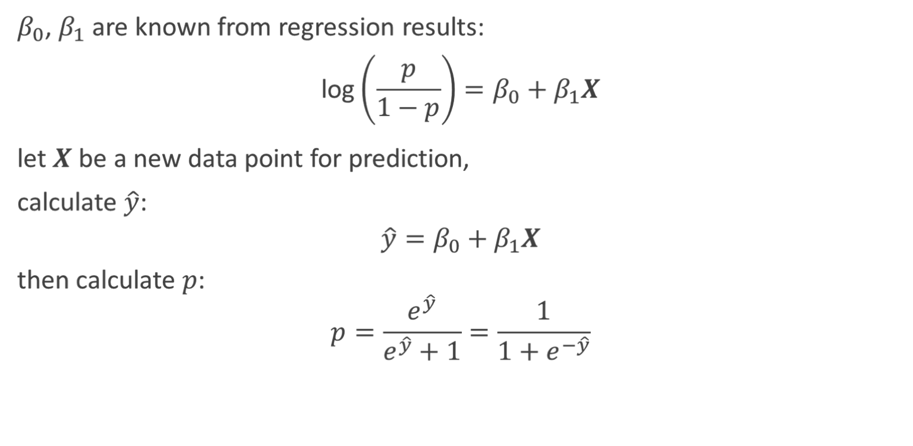
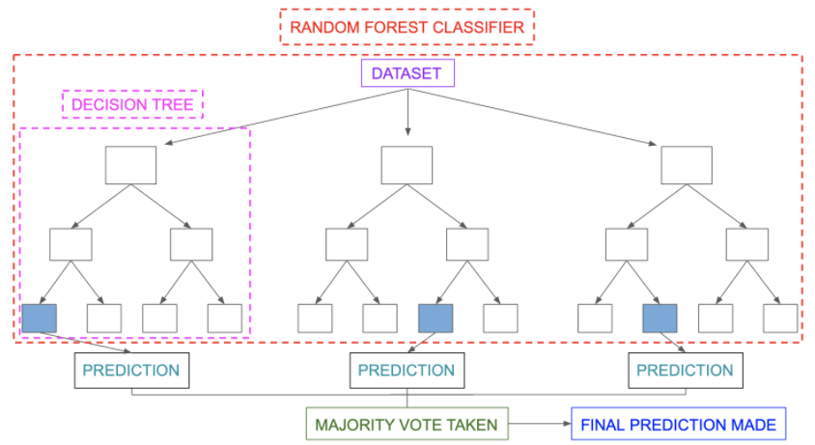
Logistic Regression
RANDOM FOREST CLASSIFIER
Hyper-parameters used:
Solver = saga
C = 100
Random state = 100
Cross-validation:
Repeated Stratified K-Fold – n_splits = 10, n_repeats = 3, random _state = 1. Mean Accuracy: 0.600, 0.589 (second model)
Evaluate using confusion matrix and ROC
Hyper-parameters used: n_estimators = 50, random_state = 100, criterion = gini
Cross-validation: Repeated Stratified K-Fold – n_splits = 10, n_repeats = 3, random _state = 1 Accuracy: 0.833 (1st), 0.828(grid search), 0.891(SFS)
Grid search used to tune hyper-parameters: n_estimators, criterion, max_features. Mean Accuracy: 0.891
Sequential Feature Selector used for feature engineering. Reduced to 45 from 92.
Evaluate using confusion matrix and ROC
Shap model used to evaluate feature importance

Slide 9
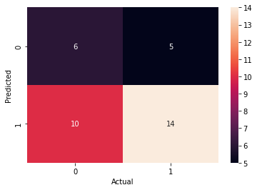
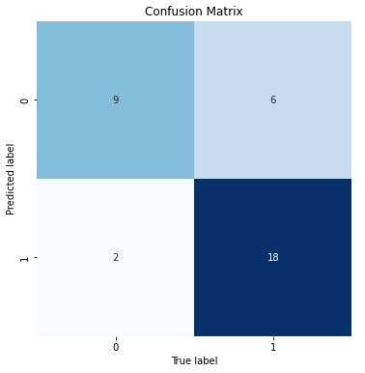
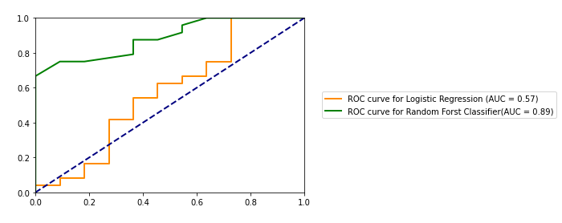
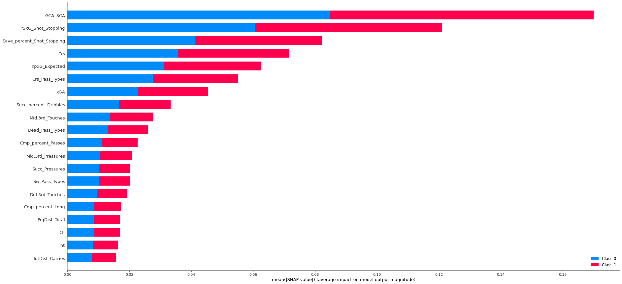
Comparison of Confusion matrices
True Negative
False Negative
False Positive
True Positive
Comparison of ROC curves
Feature importance using SHAP

Slide 10
Football success can be increased by optimizing team performance
Demonstrated that we can answer the business and data question
Apply model to statistics from other teams in the league and assess performance.
Coaches can create training plans designed to optimize the features from the models.
Improve the models using physical data - acceleration, total distance, speed zones etc. (if it can be sourced)
Players can scouted using the features from the model

Slide 11
Appendix
Resource/Package used to download data: https://cran.r-project.org/web/packages/worldfootballR/vignettes/extract-fbref-data.html
Website used to source data: https://fbref.com/en/squads/cff3d9bb/Chelsea-Stats
SK Learn Packages:
Random Forest Classifier: https://scikitlearn.org/stable/modules/generated/sklearn.ensemble.RandomForestClassifier.html
Linear Regression: https://scikitlearn.org/stable/modules/generated/sklearn.linear_model.LogisticRegression.html
Grid Search: https://scikitlearn.org/stable/modules/generated/sklearn.model_selection.GridSearchCV.html
Sequential Feature Selector: https://scikitlearn.org/stable/modules/generated/sklearn.feature_selection.SequentialFeatureSelector.html
Repeated Stratified K-Fold: https://scikitlearn.org/stable/modules/generated/sklearn.model_selection.RepeatedStratifiedKFold.html
Literature Review:
Predict soccer match outcome based on player performance - Wei Yang, DOI: 10.25236/FSR.2021.030314
Geurkink,Y.;Boone,J.; Verstockt, S.; Bourgois, J.G. Machine Learning-Based Identification of the Strongest Predictive Variables of Winning and Losing in Belgian Professional Soccer. https://doi.org/10.3390/ app11052378
Hassan, A.; Akl, A.-R.; Hassan, I.; Sunderland, C. Predicting Wins, Losses and Attributes’ Sensitivities in the Soccer World Cup 2018 Using Neural Network Analysis. Sensors 2020, 20, 3213. https://doi.org/10.3390/s20113213
Yash Ajgaonkar, Anagha Patil, Kunal Bhoyar, Jenil Shah, 2021, Prediction of Winning Team using Machine Learning, INTERNATIONAL JOURNAL OF ENGINEERING RESEARCH & TECHNOLOGY (IJERT) NTASU – 2020 (Volume 09 – Issue 03)
Carpita M, Ciavolino E, Pasca P. Exploring and modelling team performances of the Kaggle European Soccer database. Statistical Modelling. 2019;19(1):74-101. doi:10.1177/1471082X18810971

